Slide 1
Sentiment Analysis Research Project
CS 583 April 20,2017
Aditi Mallavarapu, Suganya Sivakumar

Slide 2
Preprocessing
Removed tweets labelled 2
Lemmatisation

Slide 3
Models and Evaluations: Romney Training Data
Models | Negative Class |  |  | Positive Class |  |  | Accuracy
 | Precision | Recall | F1 Score | Precision | Recall | F1 Score
Random Forest | 0.58 | 0.835 | 0.673 | 0.542 | 0.248 | 0.338 | 0.551
Adaboost | 0.553 | 0.847 | 0.656 | 0.472 | 0.268 | 0.336 | 0.522
SVM RBF | 0.582 | 0.882 | 0.685 | 0.625 | 0.263 | 0.365 | 0.565
Naïve Bayes Unigram | 0.628 | 0.727 | 0.673 | 0.465 | 0.404 | 0.431 | 0.557
Naïve Bayes Bigram | 0.60 | 0.723 | 0.656 | 0.489 | 0.356 | 0.411 | 0.544
Linear SVM | 0.610 | 0.818 | 0.684 | 0.576 | 0.363 | 0.443 | 0.575
Naïve Bayes Trigram | 0.561 | 0.847 | 0.672 | 0.501 | 0.248 | 0.333 | 0.543
Decision trees | 0.589 | 0.642 | 0.603 | 0.376 | 0.331 | 0.348 | 0.497
Multinomial Naïve Bayes | 0.588 | 0.836 | 0.677 | 0.571 | 0.299 | 0.39 | 0.561
K Nearest Neighbors | 0.569 | 0.679 | 0.606 | 0.425 | 0.243 | 0.304 | 0.401
Bernoulli Naïve Bayes | 0.621 | 0.724 | 0.658 | 0.489 | 0.431 | 0.451 | 0.554

Slide 4
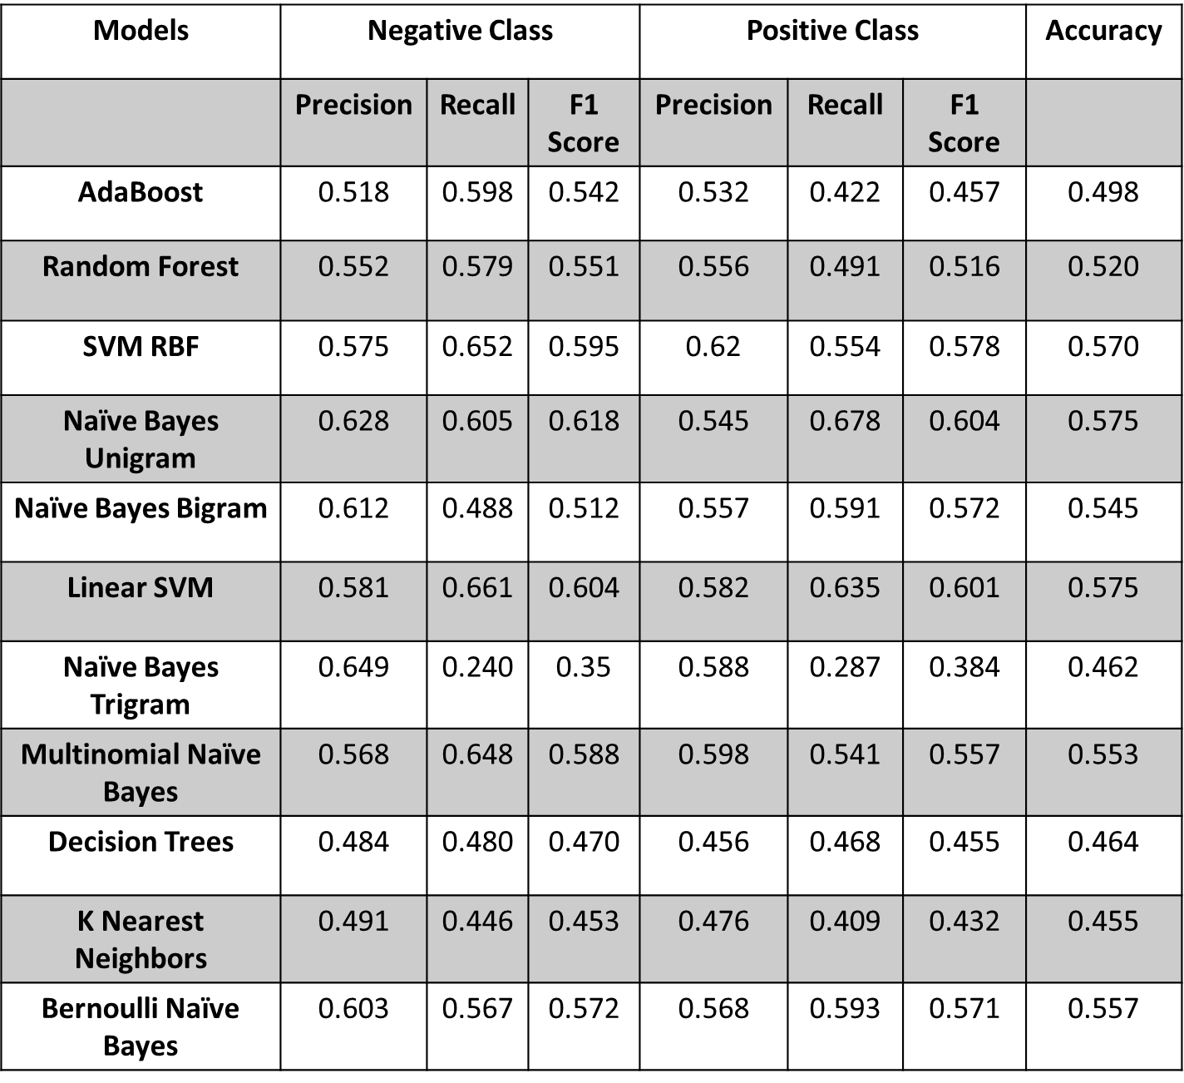
Models and Evaluations: Obama Training Data
Models | Negative Class |  |  | Positive Class |  |  | Accuracy
 | Precision | Recall | F1 Score | Precision | Recall | F1 Score
AdaBoost | 0.518 | 0.598 | 0.542 | 0.532 | 0.422 | 0.457 | 0.498
Random Forest | 0.552 | 0.579 | 0.551 | 0.556 | 0.491 | 0.516 | 0.520
SVM RBF | 0.575 | 0.652 | 0.595 | 0.62 | 0.554 | 0.578 | 0.570
Naïve Bayes Unigram | 0.628 | 0.605 | 0.618 | 0.545 | 0.678 | 0.604 | 0.575
Naïve Bayes Bigram | 0.612 | 0.488 | 0.512 | 0.557 | 0.591 | 0.572 | 0.545
Linear SVM | 0.581 | 0.661 | 0.604 | 0.582 | 0.635 | 0.601 | 0.575
Naïve Bayes Trigram | 0.649 | 0.240 | 0.35 | 0.588 | 0.287 | 0.384 | 0.462
Multinomial Naïve Bayes | 0.568 | 0.648 | 0.588 | 0.598 | 0.541 | 0.557 | 0.553
Decision Trees | 0.484 | 0.480 | 0.470 | 0.456 | 0.468 | 0.455 | 0.464
K Nearest Neighbors | 0.491 | 0.446 | 0.453 | 0.476 | 0.409 | 0.432 | 0.455
Bernoulli Naïve Bayes | 0.603 | 0.567 | 0.572 | 0.568 | 0.593 | 0.571 | 0.557

